Slide 1

NPDES Electronic Reporting Rule
NetDMR-CDX Integration Schedule
EPA Regional and State Webinar
2 November 2016

Slide 2
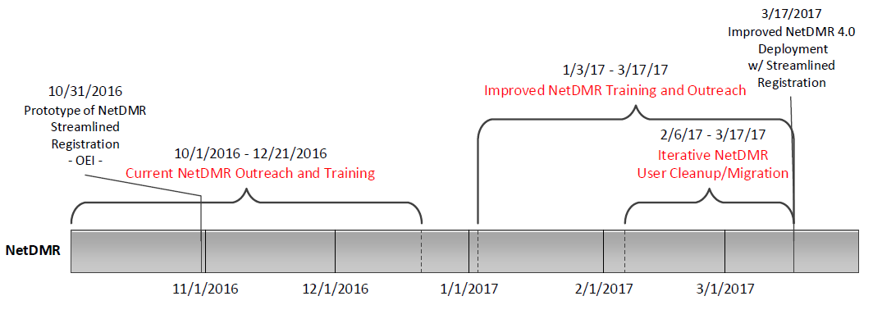
NetDMR-CDX Integration Schedule
  NetDMR integration with CDX Schedule and Coordinating tasks
  NetDMR Post Production Date: March 17, 2017
  Improved NetDMR Training and Outreach: March 1-17
  NetDMR will not be available to new users during March 10-17 (5 work days)
Notes:
Cindy
On March 17, 2017, NetDMR will be more fully integrated with EPA’s Central Data Exchange (CDX) to improve the electronic reporting process. While NetDMR will remain basically the same to submit DMRs, processes like user registration and login will change. To prepare for the integration, NetDMR will not be available to register new users, and existing user accounts will not be editable between March 10-17, 2017. However, during this period NetDMR will remain available for DMR submissions. After March 17, 2017, there will be a new NetDMR registration process, and the URL for the NetDMR will remain https://netdmr.epa.gov.

Slide 3
NetDMR-CDX Integration Schedule
(Cont.)
  EPA Support for NetDMR
  Outreach:
    Materials are available to help programs educate permittees about their reporting responsibilities.
    We are developing additional outreach materials to inform permittees about the integration with CDX.
    Our initial communication with NetDMR users about the integration will focus on migrating accounts from NetDMR to CDX.
      To successfully migrate, some accounts need to be updated.
    We will initiate a broader campaign to inform NetDMR users about the CDX integration in January 2017.
      Including posting a message on netdmr.epa.gov.
  Training:
    For the existing NetDMR tool, training is currently available for both Regulatory Authorities and permittees.
    Starting in January 2017, we will start webinar trainings on the new NetDMR tool and will make available video tutorials to replace the existing suite of online training modules.
    In addition, we will update the NetDMR user’s guides (Regulatory Authority, and Permittee & Data Provider).
Notes:
OUTREACH
Currently materials include: brochure, postcard mailing, newsletter article, sample web content, model permit language, and a draft presentation.
Materials being developed include: Materials being developed include: brochure, flyer, postcard mailing, and a call-down message.
We will consult with Regions and states to develop list of intended recipients.
We have scheduled publication of the brochure and flyer for mid-November.
TRAINING
Training is being offered via webinars, which utilize power point presentations and live demonstrations.
The schedule for permittees is available at netdmr.Zendesk.com.
There are also online training modules available. SHOW WHERE LOCATED.
These online training modules will be available through March 2017.
HELP DESK
Help desk support will also be available by emailing NPDESeReporting@epa.gov, or calling (877) 227-8965.
Type of support will include, but is not limited to:
Registration, password resetting, processing paper forms received from permittees, adjusting NPDES limits in ICIS, obtaining access to NPDES IDs, and creating facilities and permit records in ICIS.

Slide 4
NetDMR-CDX Integration Schedule (cont)
[DEMO of streamlined NetDMR registration]
https://devngn.epacdxnode.net/oeca-mock
Notes:
Joe

